Slide 1

Classification of Drug Responses for Breast and Lung Carcinoma
on the basis of Evolutionary, Driver and Clinical features
Priyamvada Kumar
02-700 M.S Research Course Spring 2021

Slide 2

Background
Assessing the contribution of tumor mutational phenotypes to cancer progression risk (Yifeng Tao. et al. ,PLoS Comput Biol. (2021))
Evaluating the molecule-based prediction of clinical drug responses in cancer (Zijian Ding. et al. , Bioinformatics (2016))
Next step ?
Notes:
Clinical features- age at initial pathological diagnosis, race etc.
Driver features- specific genes like FOXA1, LRP1B
Evolutionary features –like SNVs- GCG> GTG, CTA> CCA
Features in Brca_dfs _drug (prior to selection)
Evolutionary features 103
Driver features 24
Clinical features - 38
Features in Lung_dfs_drug (prior to selection)
Evolutionary features102
Driver features1
Clinical features 28

Slide 3
Data
Merged Lung cancer drug dataset with TCGA lung cancer dataset with features
Merged Breast cancer drug dataset with TCGA breast cancer dataset with features
Merging datasets
Feature filtering
Dropped columns like 'DrugBankID', method_of_sample_procurement, days_to_sample_procurement etc.
For Breast cancer dataset , top 4 drugs make up ~ 60 % of the total drugs tested
For Lung cancer, top 2 drugs make up ~ 42 % of total drugs tested
Drug Selection
Notes:
For Breast cancer dataset , the top 4 drugs make up ~60 % of the total drugs tested
Cyclophosphamide 91: 85 complete, 6 incomplete (3,2,1)
Doxorubicin 49 : 44 complete, 5 incomplete(2,2,1)
Docetaxel 44 :38 complete ,6 incomplete (2,1,3)
Paclitaxel 41 :32 complete ,9 incomplete (6,2,1)
For Lung cancer, top 2 drugs make up ~ 42 % of total drugs tested
Cisplatin 41 -complete 31, 10 incomplete (4,1,5)
Carboplatin 22 -11 complete response, 11 incomplete (2,3,6)
Pemetrexed 17 -11 complete , 6 incomplete (3,0,3)
Vinorelbine 15 -12 complete, 3 incomplete (0,1,2)

Slide 4
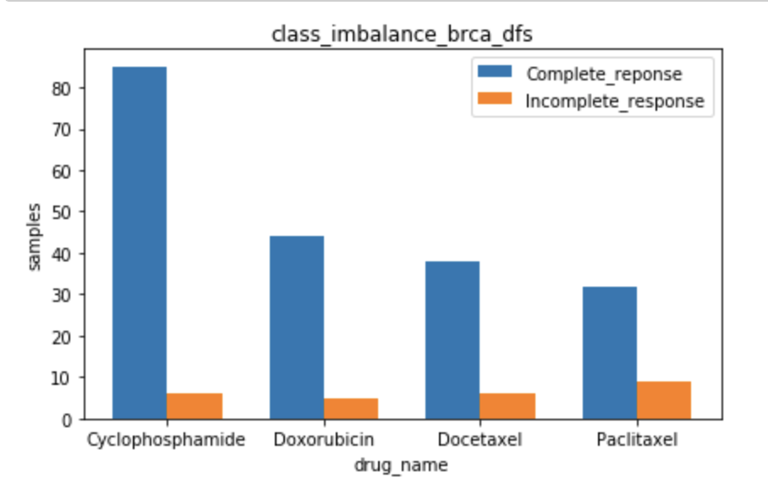
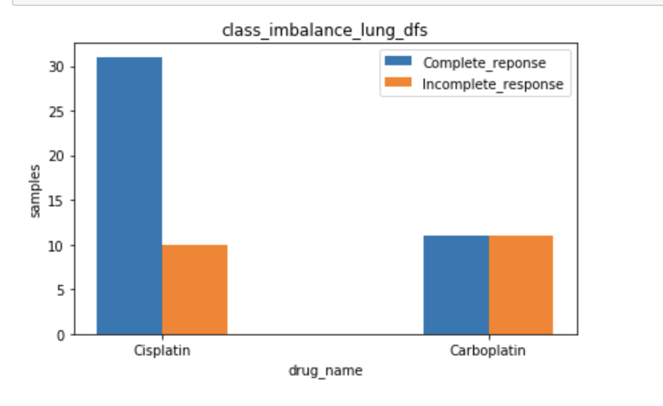
Drug Responses
Fig. 1 Drug response in breast cancer dataset
Fig. 2 Drug response in lung cancer dataset

Slide 5
Classification - Complete vs Incomplete drug response
Feature Selection
Encode Response Variable
Oversampling and Undersampling
Data Preprocessing
Train - Test Split
Models fitted with GridSearchCV
with Stratified Cross Validation
Data Scaling
Check model performance on test set
with best hyperparameters
Metrics Output

Slide 6
Results : GridSearchCV
Models | Random Forest | K Nearest Neighbors | Multilayer Perceptron | SVC | SVC (balanced)
Hyperparameters tested | Max_depth:[80,10] max_features: [2, 3] min_samples_split: [2,8,10] n_estimators: [100,200] | n_neighbors: [5,9,19] weights: ['uniform','distance'] metric: ['minkowski', 'Manhattan', 'euclidean'] | hidden_layer_sizes: [100,200], alpha: [0.0001,0.001] learning_rate: ['constant', 'adaptive'] max_iter:[400,500] | C: [0.1, 1, 10, 100, 1000], kernel: ['linear', 'rbf'], gamma:[1, 0.1, 0.01, 0.001,'scale'] | C: [0.1, 1, 10, 100, 1000], kernel: ['linear', 'rbf'], gamma:[1, 0.1, 0.01, 0.001,'scale']

Slide 7
Wilcoxon unpaired test + Correlation filtering Lung cancer + Carboplatin
p=0.1 , features=8
p=0.5 , features= 49
MODEL | Accuracy | Precision | Recall | F1 | roc_auc | Accuracy | Precision | Recall | F1 | roc_auc
Baseline SVC | 0.75 | 1.00* 0.67** | 0.50* 1.00** | 0.67* 0.80** | 0.68 | 0.62 | 0.67* 0.60** | 0.50* 0.75** | 0.57* 0.67** | 0.62
SVC+CV | 0.62 | 0.60* 0.67** | 0.75* 0.50** | 0.67* 0.57** | 0.62 | 0.62 | 0.67* 0.60** | 0.50* 0.75** | 0.57* 0.67** | 0.62
Weighted SVC+CV | 0.62 | 0.60* 0.67** | 0.75* 0.50** | 0.67* 0.57** | 0.62 | 0.62 | 0.67* 0.60** | 0.50* 0.75** | 0.57* 0.67** | 0.62
RF | 0.50 | 0.50* 0.50** | 0.50* 0.50** | 0.50* 0.50** | 0.50 | 0.62 | 0.67* 0.60** | 0.50* 0.75** | 0.57* 0.67** | 0.62
KNN | 0.50 | 0.50* 0.50** | 0.50* 0.50** | 0.50* 0.50** | 0.50 | 0.75 | 0.75* 0.75** | 0.75* 0.75** | 0.75* 0.75** | 0.75
MLP | 0.88 | 1.00* 0.80** | 0.75* 1.00** | 0.86* 0.89** | 0.87 | 0.62 | 0.67* 0.60** | 0.50* 0.75** | 0.57* 0.67** | 0.62
Notes:
Also tried Leave one out cross validation in place of stratified cross validation but there was no improvements in metrics …again, tried refit=roc_auc but results were the same .

Slide 8
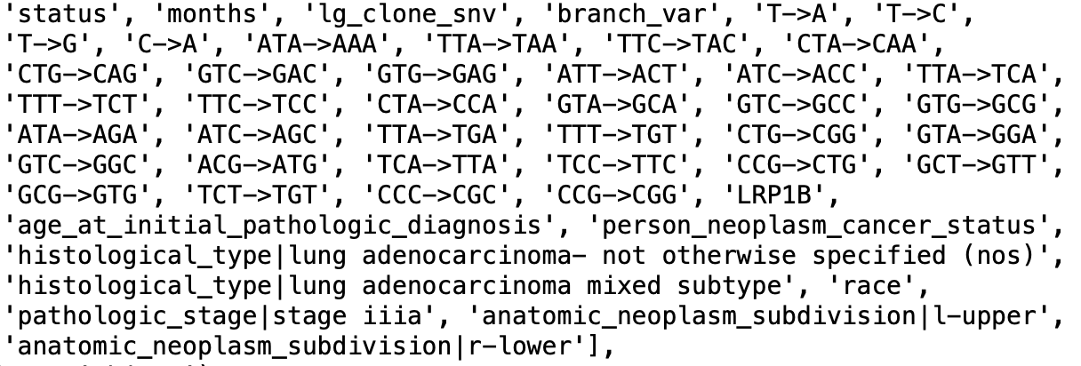
At p = 0.1
At p = 0.5

Slide 9
Wilcoxon unpaired test + Correlation filtering Lung cancer + Cisplatin
p=0.1 , features=3
p=0.5 , features=35
MODEL | Accuracy | Precision | Recall | F1 | roc_auc | Accuracy | Precision | Recall | F1 | roc_auc
Baseline SVC | 0.64 | 0.80* 0.25** | 0.73* 0.33** | 0.76* 0.29** | 0.51 | 0.78 | 0.79* 0.00** | 1.00* 0.0** | 0.88* 0.00** | 0.54
SVC+CV | 0.71 | 0.88* 0.33** | 0.64* 0.67** | 0.74* 0.44** | 0.65 | 0.64 | 0.80* 0.25** | 0.73* 0.33** | 0.76* 0.29** | 0.53
Weighted SVC+CV | 0.71 | 0.88* 0.33** | 0.64* 0.67** | 0.74* 0.44** | 0.65 | 0.64 | 0.80* 0.25** | 0.73* 0.33** | 0.76* 0.29** | 0.53
RF | 0.64 | 0.75* 0.00** | 0.82* 0.00** | 0.78* 0.00** | 0.40 | 0.79 | 0.79* 0.00** | 1.00* 0.00** | 0.88* 0.00** | 0.50
knn | 0.71 | 0.82* 0.33** | 0.82* 0.33** | 0.82* 0.33** | 0.57 | 0.79 | 0.83* 0.50** | 0.91* 0.33** | 0.87* 0.40** | 0.62
MLP | 0.64 | 0.75* 0.00** | 0.82* 0.00** | 0.78* 0.00** | 0.40 | 0.57 | 0.73* 0.00** | 0.73* 0.00** | 0.73* 0.00** | 0.36

Slide 10
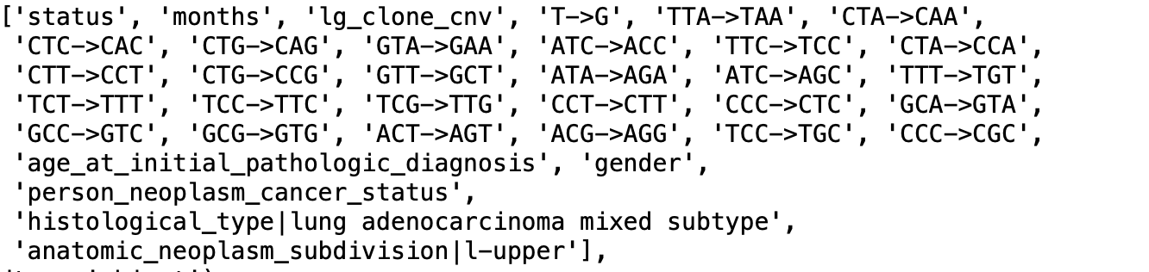
At p=0.1
At p=0.5

Slide 11
Wilcoxon unpaired test + Correlation filtering Breast cancer + Paclitaxel
p=0.1 , features= 5
p=0.5 , features= 49
MODEL | Accuracy | Precision | Recall | F1 | roc_auc | Accuracy | Precision | Recall | F1 | roc_auc
Baseline SVC | 0.64 | 0.77* 0.00** | 0.91* 0.00** | 0.83* 0.00** | 0.27 | 0.78 | 0.79* 0.00** | 1.00* 0.00** | 0.88* 0.00** | 0.36
SVC+CV | 0.64 | 0.75* 0.00** | 0.82* 0.00** | 0.78* 0.00** | 0.40 | 0.64 | 0.80* 0.25** | 0.73* 0.33** | 0.76* 0.29** | 0.53
Weighted SVC+CV | 0.64 | 0.75* 0.00** | 0.82* 0.00** | 0.78* 0.00** | 0.40 | 0.64 | 0.80* 0.25** | 0.73* 0.33** | 0.76* 0.29** | 0.53
RF | 0.71 | 0.77* 0.00** | 0.91* 0.00** | 0.83* 0.00** | 0.45 | 0.79 | 0.79* 0.00** | 1.00* 0.00** | 0.88* 0.00** | 0.50
KNN | 0.71 | 0.77* 0.00** | 0.91* 0.00** | 0.83* 0.00** | 0.45 | 0.71 | 0.77* 0.00** | 0.91* 0.00** | 0.83* 0.00** | 0.45
MLP | 0.71 | 0.77* 0.00** | 0.91* 0.00** | 0.83* 0.00** | 0.45 | 0.71 | 0.77* 0.00** | 0.91* 0.00** | 0.83* 0.00** | 0.45

Slide 12
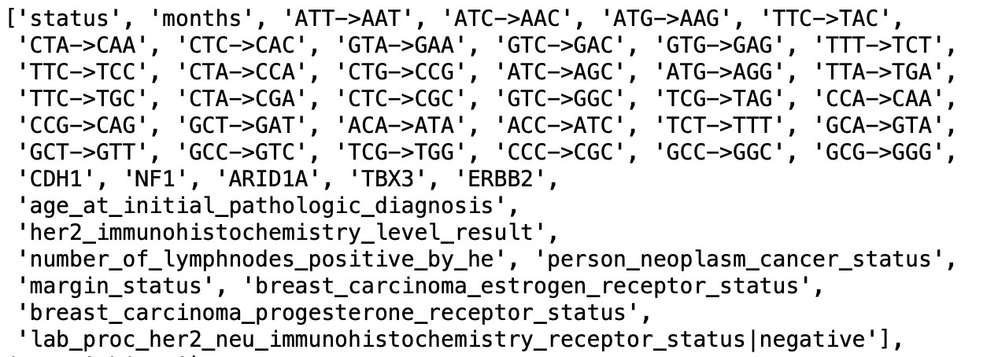
At p=0.1
At p=0.5

Slide 13
ANOVA F-test based feature selection Lung cancer + Carboplatin
 | Accuracy | Precision | Recall | F1 | roc_auc
Baseline SVC | 0.62 | 0.67* 0.60** | 0.50* 0.75** | 0.57* 0.67** | 0.62
SVC+CV | 0.62 | 0.67* 0.60** | 0.50* 0.75** | 0.57* 0.67** | 0.62
Weighted SVC+CV | 0.62 | 0.67* 0.60** | 0.50* 0.75** | 0.57* 0.67** | 0.62
RF | 0.75 | 1.00* 0.67** | 0.50* 0.1.00** | 0.67* 0.80** | 0.75
knn | 0.62 | 0.67* 0.60** | 0.50* 0.75** | 0.57* 0.67** | 0.62
MLP | 0.75 | 0.75* 0.75** | 0.75* 0.75** | 0.75* 0.75** | 0.75
Notes:
Set Threshold =2 , 30 features -performance is no better than what we had using wilcoxon +correlation filtering
status
months
T->A
CTA->CAA
CTC->CAC
GTG->GAG
ATC->ACC
TTA->TCA
CTA->CCA
CTG->CCG
ATC->AGC
TTA->TGA
CTG->CGG
GTC->GGC
ACT->AAT
ACG->AAG
TCA->TAA
TCG->TAG
CCC->CAC
CCG->CAG
GCA->GAA
GCT->GAT
CCG->CGG
GCT->GGT
age_at_initial_pathologic_diagnosis
person_neoplasm_cancer_status
histological_type|lung adenocarcinoma mixed subtype
race
pathologic_stage|stage iiia
anatomic_neoplasm_subdivision|l-upper

Slide 14
ANOVA F-test based feature selection Lung cancer + Cisplatin
 | Accuracy | Precision | Recall | F1 | roc_auc
Baseline SVC | 0.79 | 0.83* 0.50** | 0.91* 0.33** | 0.87* 0.40** | 0.79
SVC+CV | 0.73 | 0.82* 0.33** | 0.82* 0.33** | 0.82* 0.3** | 0.57
Weighted SVC+CV | 0.73 | 0.82* 0.33** | 0.82* 0.33** | 0.82* 0.3** | 0.57
RF | 0.71 | 0.77* 0.00** | 0.91* 0.00** | 0.83* 0.00** | 0.45
knn | 0.73 | 0.82* 0.33** | 0.82* 0.33** | 0.82* 0.3** | 0.57
MLP | 0.73 | 0.82* 0.33** | 0.82* 0.33** | 0.82* 0.3** | 0.57
Notes:
Threshold =2 , 24 features -performance is no better than what we had using wilcoxon +correlation filtering
'status', 'months', 'lg_clone_cnv', 'cnv_rate', 'cnv_lg_rate',
'cnv_sm_rate', 'CTG->CAG', 'GTA->GAA', 'CTA->CCA', 'CTG->CCG',
'GTT->GCT', 'ATA->AGA', 'ATC->AGC', 'TCC->TTC', 'CCT->CTT', 'GCC->GTC',
'GCG->GTG', 'ACT->AGT', 'ACG->AGG', 'gender',
'person_neoplasm_cancer_status',
'histological_type|lung adenocarcinoma mixed subtype',
'pathologic_stage|stage ib', 'anatomic_neoplasm_subdivision|l-upper',

Slide 15
Future steps
Bigger dataset and better data pre-processing methods
Advanced machine learning tools
Better over and under sampling strategies
GridSearchCV only tests hyperparameters that are fed into ‘param_grid’. Including more parameters can be computationally expensive - Better feature engineering and feature selection methods may improve results
Semi supervised learning - Anomaly detection
Notes:
More computational resources
- Can have only complete response data as input and then detect incomplete response as the outlier in test set .Can use reconstruction error as threshold to differentiate between normal and outlier sample
- Change how drug response are grouped - stable disease, partial response, clinical progressive disease

Slide 16
References
[1] Tao Y, Rajaraman A, Cui X, Cui Z, Chen H, Zhao Y, Eaton J, Kim H, Ma J, Schwartz R. Assessing the contribution of tumor mutational phenotypes to cancer progression risk. PLoS Comput Biol. 2021 Mar 12;17(3):e1008777
[2] Ding Z, Zu S, Gu J. Evaluating the molecule-based prediction of clinical drug responses in cancer. Bioinformatics. 2016 Oct 1;32(19):2891-5
[3] Batista, Gustavo E. A. P. A. and Prati, Ronaldo C. and Monard, Maria Carolina A Study of the Behavior of Several Methods for Balancing Machine Learning Training Data Association for Computing Machinery, 6(1), https://doi.org/10.1145/1007730.1007735 , 2004
[4] Ma, Shuangge and Huang,Jian Penalized feature selection and classification in bioinformatics Briefings in Bioinformatics, Volume 9, Issue 5, https://doi.org/10.1093/bib/bbn027, 2008
[5]Paula Branco, Luis Torgo, Rita Ribeiro. Survey of Predictive Modelling under Imbalanced Distributions. arXiv 1505.01658 (2015)
[6]Fionn Murtagh Multilayer perceptrons for classification and regression Neurocomputing, 2(5),https://doi.org/10.1016/0925-2312(91)90023-5, 2004
[7]S. Yang, R. Zhang, F. Nie and X. Li, "Unsupervised Feature Selection Based on Reconstruction Error Minimization," ICASSP 2019 - 2019 IEEE International Conference on Acoustics, Speech and Signal Processing (ICASSP), 2019, pp. 2107-2111, doi: 10.1109/ICASSP.2019.868273

